Slide 1


SAP Full-Stack Developer training
ABAP on HANA, UI5 & Fiori, Analytics with OData
Anubhav Oberoy
Day – 18

Slide 2

Agenda – Day 18
Introduction of Planning
SAC Planning Model Basics
Understanding Planning Jargons
Creating Planning Model
Implementing Planning Scenario
--Break--
Introduction of Machine Learning
Describing Predictive Model & Techniques
Types of ML
Analytics and Predictive Analytics
Understanding Classification
Concept of Confusion Matrix
Creating Classification Scenario

Slide 3

What is Planning ?
Planning is a fundamental management function, which involves deciding before head,
What is to be done – TV Commercial
When it will be done – Q1 2021
How it will be done – Allocated 2 mn$
Who is going to do it – Marketing team
Planning is an intellect process which lays down organization objectives and can we achieve the goals which are set and time bound. It chalks out exact how to attain a specific goal. For example how many people I need to hire to achieve a sales of 20 bn mark this year.
Planning is performed for various functions of a company,
such as sales planning, expense, cost.
Planning, and core financials planning to report your co.
numbers to the shareholder.
HR plans for people at all suggested levels
(like Manager, VP, SVP, Associates).
Planning helps us to increase Coordination
and onerous tasks at any co.
Software Innovation
Hardware Innovation

Slide 4
SAC Planning Model Basics
Planning data always have version (Categories – Actuals, Forecast, Budget) - IFRS
2. It is mandatory to have DATE/TIME dimension for the planning model in SAC.
3. We can additionally have Organization Dimension also known as Entity (location of the business) made available in planning model, which helps to get break-up of FIN data.
Region -> Country -> State -> Cities -> Entity (associate with Currency)
Category1
Category 2
Category 3
Actuals
Budget
Forecast
Current facts data which is based on most recent experience or past experience. They relates to reality.
Budgeting is the financial direction of where management wants to take the company, helping qualifying expectations of revenue that business wants to achieve for most recent future
Tells about whether the budget is on track, are we headed in the right direction. Estimating the amount, revenue and income that will achieve in near future.
Software Innovation

Slide 5

SAC Planning Model Basics
4. Account Dimension –
Represents an account in balance sheet like Gross Profit, Net Revenue, Operating Margin..
Account Dimension always have parent-child hierarchy built automatically
It is used to record, apply formula and aggregate values together.
Each a/c dimension can have a contribution to our Financial planning numbers
+VE – INC, INTINC
- VE – EXP, INT
Neutral – NFIN
5. We can define Business Rules.
6. We plan in local currencies at each entity level and we can report in a common currency - Average, Fix.
7. We will have parent-child hierarchies when we have 2 dimensions together,
its also possible to have one model with both P-C and Level-based hierarchy in SAC.
Software Innovation

Slide 6
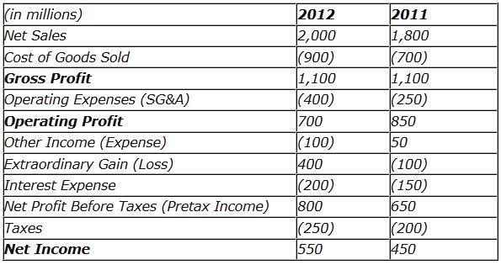

Planning Jargons
Revenue
Total amount of goods and services produced in a span of time is called revenue. – GDP (Country)
Gross Revenue
Total income earned by a co in a specific period, an indicator of potential for growth.
Gross Revenue = Units X Price
Net Revenue
Gross revenue – discounts – returns
Quality of products
Gross Profit = Net Revenue – Cost of Goods (Raw, Machines, Labor, Packaging, Shipping)
Gross Margin % = Gross Profit / Net Revenue
Operating Profit % - operating income / Net Revenue
Operating Expense Ratio % = Operating Expense / Net Revenue

Slide 7
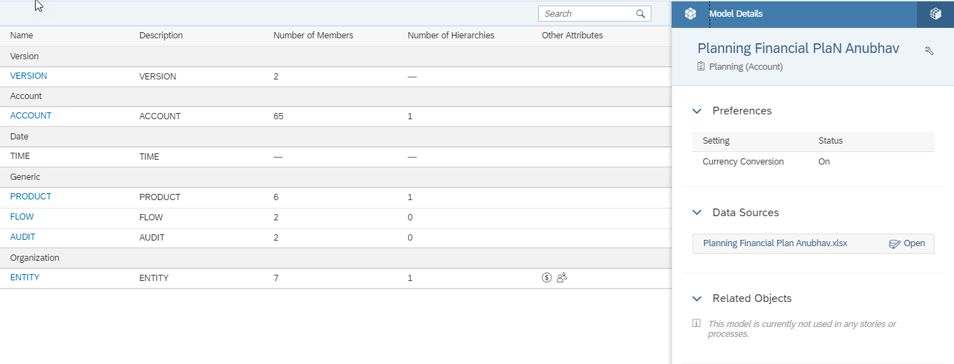
Creating Planning Model
Software Innovation
Hardware Innovation

Slide 8

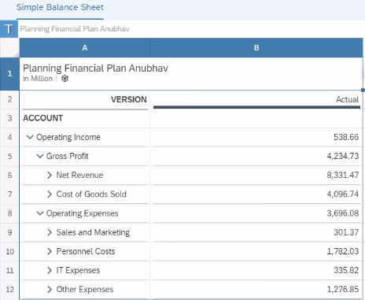
Implementing Planning in Story
Simple Balance Sheet

Slide 9
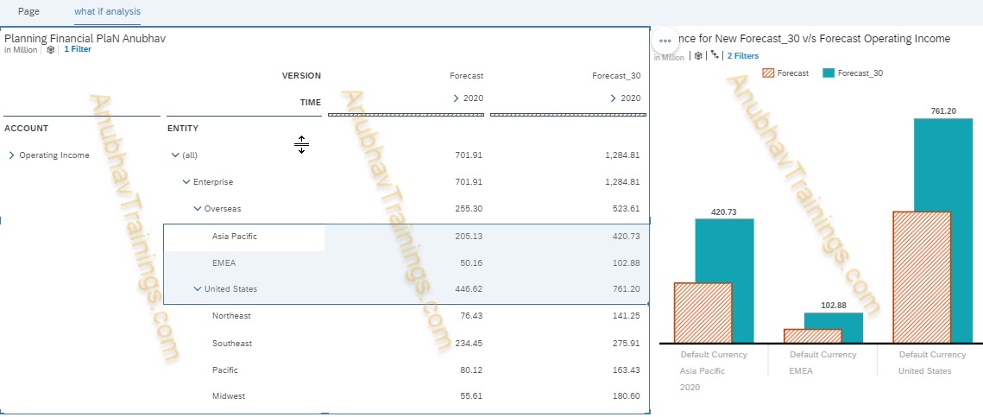
Implementing What if Analysis Scenario
Where the business will ask us, what will happen to our account in case there is change happens in another account.
Also change value based on absolute or %
Increase or decrease an a/c by %
Distribute or spread a value
Variance chart

Slide 10

Break

Slide 11

Introduction of Machine Learning
Machine learning is an application of artificial intelligence (AI) that provides systems the ability to automatically learn and improve from experience without being explicitly programmed. Machine learning focuses on the development of computer programs that can access data and use it to learn for themselves.
It is a field of study that gives computers the capability to
learn w/o being programmed explicitly.
e.g. Amazon
Does amazon hire a person to check our search last time and propose
similar products/movies when we browse again. – No.
Purpose of ML is to reduce human efforts and mistakes.
Allows operations to run smoothly once we find best optimum predictive model.

Slide 12

Predictive Model & Techniques
Modeling is a process by which machine learning tries to find/create best model for our use case. The model is created to predict an outcome. Model evaluation is an integral part of the modeling/development process. In order to find the best model, ML usage the mathematical algorithms.
Predictive models use known results to develop (or train) a model that can be used to predict values for different or new data.
The modeling results in predictions that represent a probability of the target variable (for example, revenue) based on estimated significance from a set of input variables.
Hardware Innovation

Slide 13
Types of Machine Learning
01
Supervised Learning
Train our model -> Training Set, Model, Validation Set, Retrain
Algo – decision tree, native bias, Regression, Logistic regression, Multi-regression, SVM…
Scenarios – Regression and Classification comes under supervised learning.
1
02
Un-Supervised Learning
2
Let the machine work on the data like a child, you give huge data to machine and let machine find out odd patterns and trends with patterns in the dataset.
Algo: k-means, hierarchical, apriori, trend analysis.
Scenario – Time Series
Software Innovation
3
03
Re-enforcement Learning
Candy-stick approach. If you do good- candy and if not good – stick
Robotics.
3
Hardware Innovation

Slide 14

Analytics and Predictive Analytics
Analytics : Is used to create visualization on historic data that will just gives us insight. Just as-is state.
Predictive Analytics – When we want to predict future/forecast, then we are doing predictive analytics.
The future state and projection.
When we put analytics with predictive analytics we get a VISION.
Hardware Innovation

Slide 15
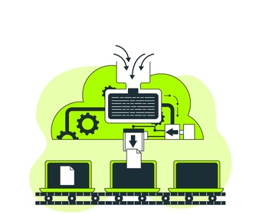
What is Classification
In machine learning, classification refers to a predictive modeling problem where a class label is predicted for a given example of input data. Examples of classification problems include: Given an example, classify if it is spam or not. Given a handwritten character, classify it as one of the known characters.
A common job of machine learning algorithms is to recognize objects and being able to separate them into categories. This process is called classification, and it helps us segregate vast quantities of data into discrete values, i.e. :distinct, like 0/1, True/False, or a pre-defined output label class.

Slide 16
Calculate Accuracy
For classification we applied different-different algorithm to determine best possible model. We got multiple models but we don’t know which one is best. Hence we need to have some parameters which qualifies a model as near-perfect or better than others.
There are different ways to determine accuracy of a model.
STEP ONE
01
Confusion Matrix
AUC Chart.
02
03
STEP THREE
ROC Curve.
STEP TWO
Hardware Innovation

Slide 17
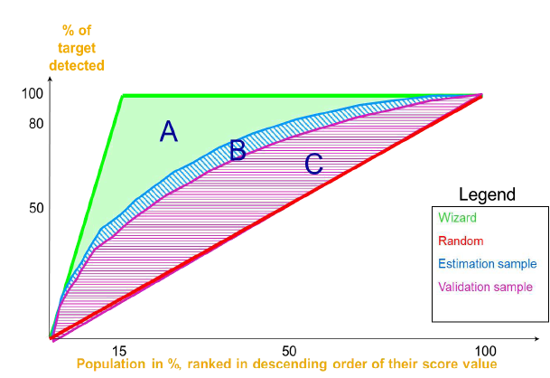
Confusion Matrix
A confusion matrix is a table that is often used to describe the performance of a classification model
(or "classifier") on a set of test data for which the true values are known.
The confusion matrix itself is relatively simple to understand, but the related terminology can be confusing.
Metrics | Definitions
Classification Rate | Percentage of targets accurately classified by the model when applied on the validation data sets (TP+TN) / N ~ also known as accuracy of model
Sensitivity (TPR) | Percentage of actual positive targets that have been correctly predicted. TP/(TP+FN)
Specificity (FPR) | Percentage of negative targets that have been incorrectly detected as positive. FP / (FP + TN) = 1 - specificity
Precision | Percentage of predictive positive targets that are actually positive targets. TP/(TP+FP)
FI score | Harmonic mean of Precision and Recall (Recall and Precision are evenly weighted). F1 = 2 (Precision X Recall) / (Precision + Recall)
ROC Curve
An ROC curve (receiver operating characteristic curve) is a graph showing the performance of a classification model at all classification thresholds. This curve plots two parameters: True Positive Rate. False Positive Rate.

Slide 18
Steps for Implementing Predictive Scenario
8. Create Dashboard.
7. Create a model on output dataset
1. Create dataset into the SAC system using Train_data.
6. Apply dataset and produce output dataset – Predicted
Category, assigned bin and probability.
2. Create a model
using dataset and
create a simple
Dashboard -ML Starts
Steps :
Software Innovation
3. Create a new classification scenario
5. Train model
4. Provide input data
set, target (flight risk), excluded variables

Slide 19
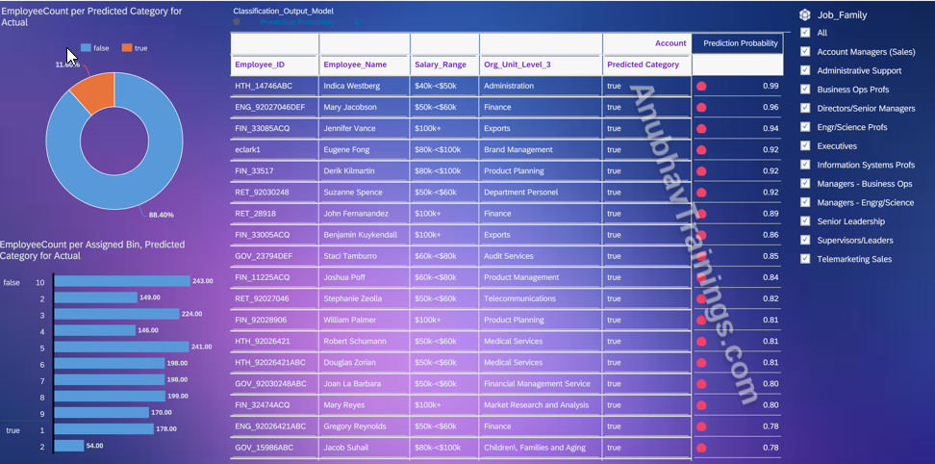
Classification Scenario Dashboard

Slide 20

End of Day 18

Slide 21

Questions

Slide 22

Anubhav Oberoy

Slide 23


We’re committed to empower you to be
Most Desirable Resource
through powerful training solutions.
We build the workforce of the future.
250+
Corporate Clients
30,000+
Learners Trained
25000+
Learners Placed
FREE WEBINARS
Sign up for free webinars with industry experts every fortnight!
Enroll Now!
Contact us today!
https://anubhavtrainings.com/

Slide 24




More from AnubhavTrainings.com

